Slide 1
Whitehouse Primary School 80th Birthday

Slide 2
In the beginning…
Our school first opened on 24th September 1938.
There were 3 teachers, 140 pupils and 4 classrooms.
There was no assembly hall, BUT there was a football pitch!!

Slide 3
Did you know…?
During the 2nd World War our school was used as a ‘rest centre’ for refugees and 2 air raid shelters were built at the back of the school.
In 1941 the football team competed in its first league.
The PTA was formed in 1946.
The biggest number of pupils ever at Whitehouse was 800!
The first time pupils went on a school trip all the local people lined the streets to wave to them!

Slide 4
What next?
In 1951 work began on a new school building – it cost £87,000.
We stayed in that building until 2009 and then moved next door into a corridor in a secondary school.
We were told we wouldn’t get a new school…

Slide 5
What next?

Slide 6
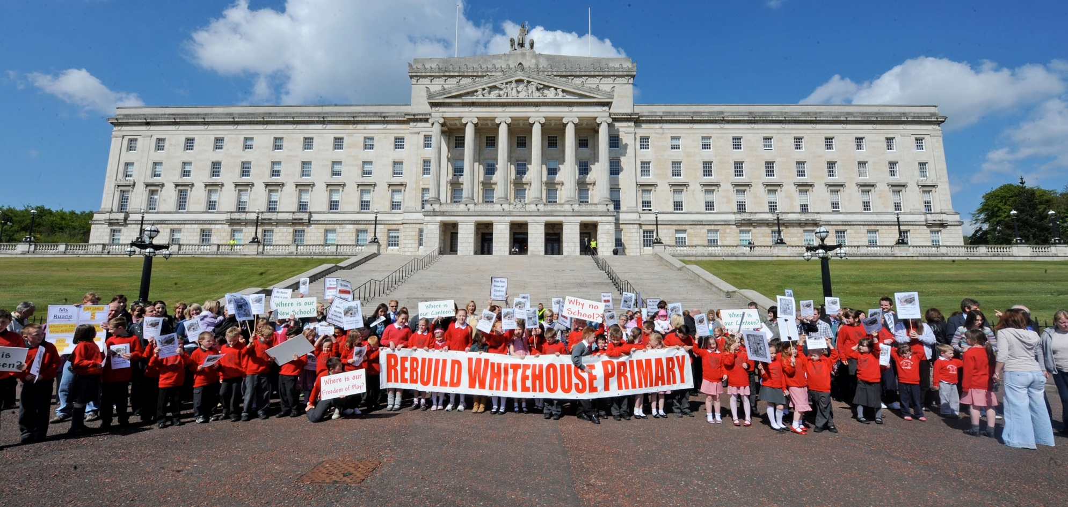
What next?

Slide 7
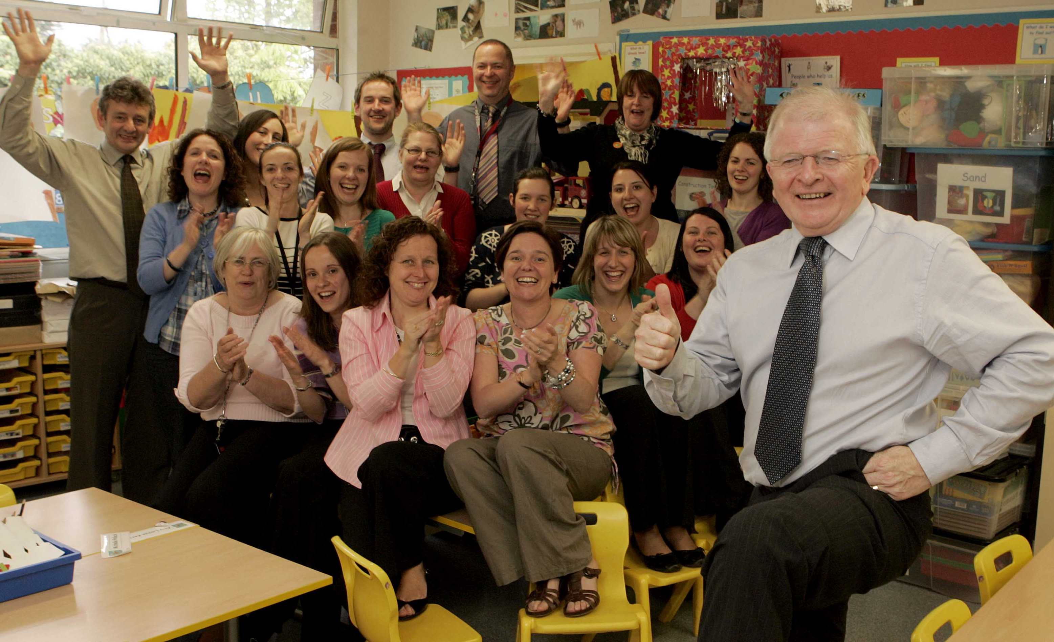
What next?

Slide 8
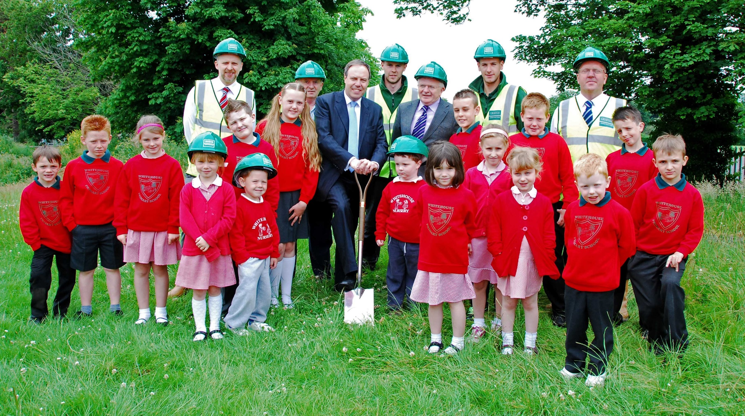
What next?

Slide 9
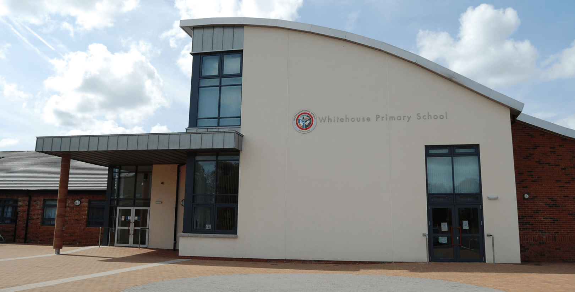
What next?
Our new building opened in 2011 and we now have 464 pupils!

Slide 10
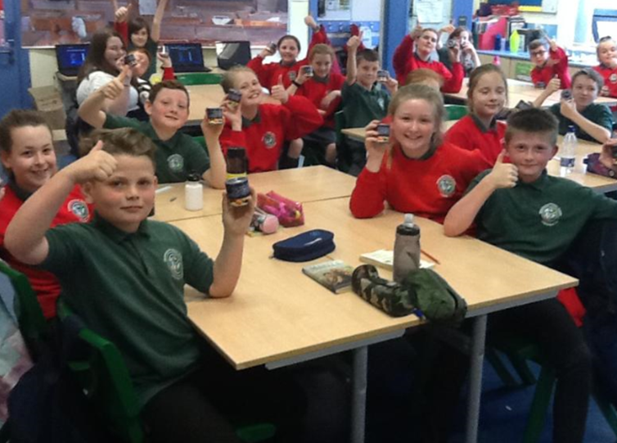
What next?

Slide 11
What next?

Slide 12
Happy Birthday!

