Slide 1
Eco team Assembly 16/11/18

Slide 2
Waste
Notes:
We would like to read you a story today. It is a story about a town that didn’t think about their waste and what it did to our world. We have asked you to be food waste superheroes so today we would like to introduce you to another super hero. His name is Michael Recycle!

Slide 3
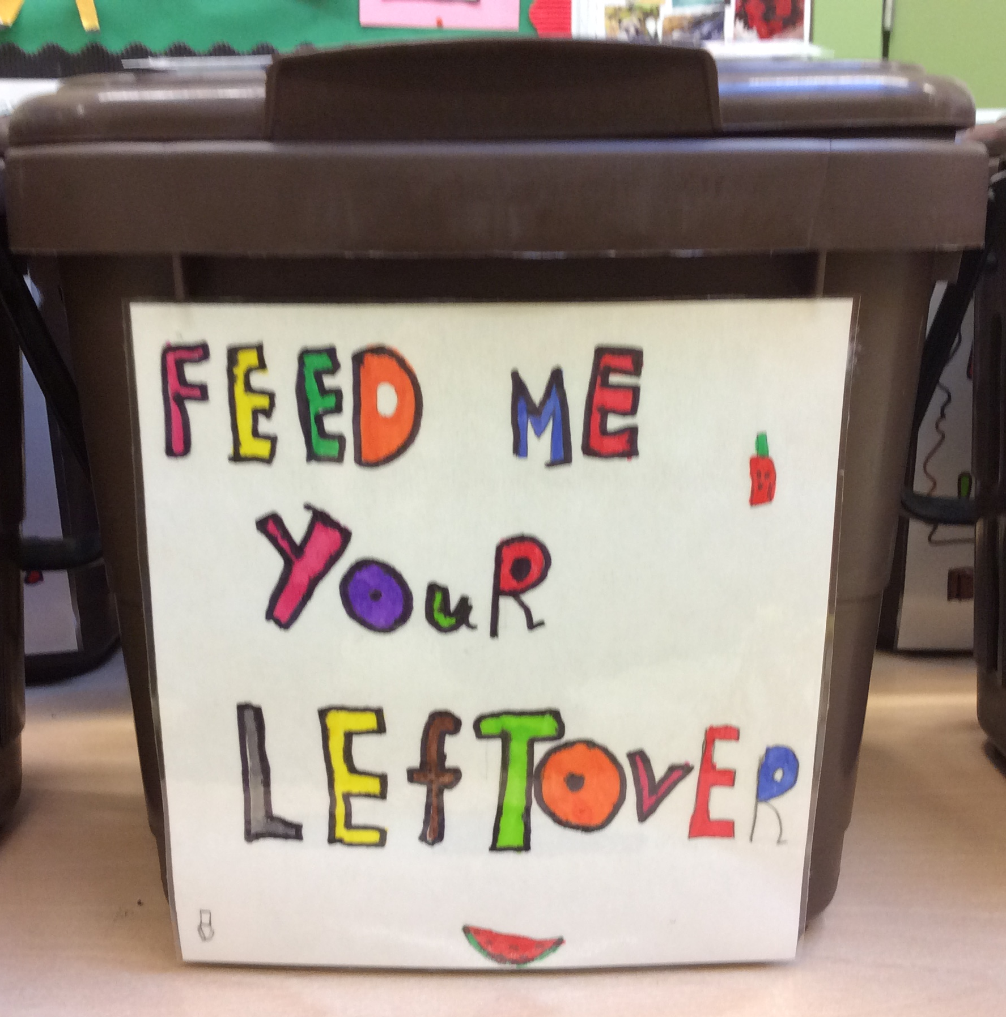
Waste superheroes!
You can be a waste superhero just
like Michael Recycle.
Here’s what you can do to help!
Keep using the feed me bins in the
classrooms and the brown bins
in the playgrounds.
Notes:
You can be a waste superhero just like Michael Recycle. Here’s what you can do to help!
Keep using the feed me bins in the classrooms and the brown bins in the playgrounds.
Cash for Clobber are giving us a big textile bin for old clothes. They will give us money linked to the weight of clothes collected. Some of this money can also be given to Cancer Fund for Children.

Slide 4
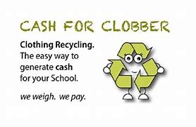
Cash for Clobber
Recycle old clothes in our cash for clobber scheme
Cash for Clobber are giving us a big textile bin
for old clothes.
They will give us money linked to the weight of
clothes collected.
Some of this money can also be given to
Cancer Fund for Children.
Notes:
Cash for Clobber are giving us a big textile bin for old clothes. They will give us money linked to the weight of clothes collected. Some of this money can also be given to Cancer Fund for Children.
The term ‘Single use plastic’ has been on the news a lot. Water NI came out to talk to the Eco team about reducing the amount of single use plastic at our school. We will be starting a new scheme during New Year New You to help reduce our plastic waste.

Slide 5
Single use plastic
Notes:
The term ‘Single use plastic’ has been on the news a lot. Water NI came out to talk to the Eco team about reducing the amount of single use plastic at our school. You can help by using reusable plastic bags when shopping. Put your sandwiches in a reusable tub and not cling film. Cling film cant be recycled!
We will be starting a new scheme during New Year New You to help reduce our plastic waste. We will be giving each child and teacher a reusable water bottle from Water NI. By January, Whitehouse primary will be free of single use plastic bottles!

Slide 6
Single waste plastic
The term ‘Single use plastic’ has been on the news a lot.
Water NI came out to talk to the Eco team about reducing the amount of single use plastic at our school.
We will be starting a new scheme during New Year New You to help reduce our plastic waste.

Slide 7
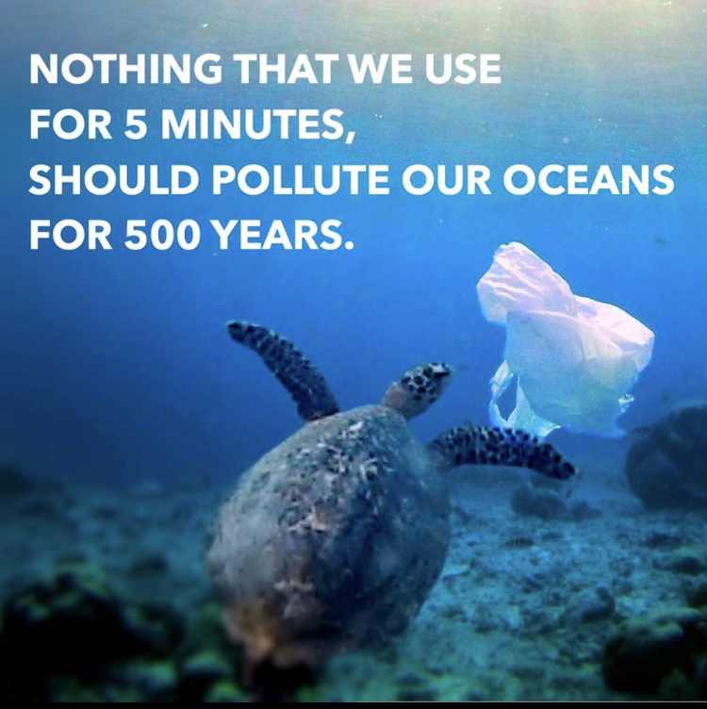
We all can make a difference!
Notes:
We will leave you with these 2 images.
Did you know that shops in Northern Ireland gave out close to 100 million plastic bags last year!
Nothing that we use for 5 minutes, should pollute our oceans for 500 years!
Small changes can lead to big changes!

